Slide 1
mydlink+
NEW 3.0.0
- For iOS -
2013.05.31

Slide 2
Date | ID | Revise
2013.05.31 | BEL | Revise New 300 for combine 120 300 310 in the future.
2013.05.02 | BEL | Revise Detection from 300
2013.04.24 | BEL | Rebuild from 310

Slide 3
mydlink+ New 300 for iOS
0. Plus Entrance
My Devices
1.1 Entrance
1.2 Push Notification
1.3 Menu
1.4 New Features
2. Unsupported Devices
Camera
A1. Cloud NVR
A2. Live View
A3. Playback
A4. Related Apps
A5. Settings (Camera)
B. Router
1.1 Status
2.1 Related Apps
3.1 Settings (Router)
C. NVR (DNR-322L)
1.1 DNR-322L
D. DIR-508 + DCS-300

Slide 4
0. Plus Entrance

Slide 5
0.1 Sign in
When keyboard slide up:
Move and scale mydlink logo.
Move the input form and button.
If wrong account/password, popup a dialog
When input E-mail, return key is “Next”
When input Password, return key is “Go”

Slide 6
0.2 Connection failed
When internet connection unavailable, it check if it’s a mydlink router.
If yes, popup a dialog to ask if user want to reboot router. If no -> follow the flow of original.
If password failed, popup a message and automatically fade out after 3 seconds or any tap on screen, than back to popup dialog.
Content from PP
[title]: Internet connection failed
[text]: Your router failed to connect to the Internet. Do you want to reboot it to connect again?

Slide 7
0.3 Emergency site information popup
Emergency site information popup.
Tap OK to close popup, back to sign in page with already inputted E-mail and password.

Slide 8
0.4 Newer Version Needed
When a newer version of mydlink plus is detected, popup a dialog to alert user.
If force upgrade:
(1) Tap “Skip” to exit app. (2) Tap “Upgrade” to mydlink plus page in app store.
If not force upgrade:
(1) Tap “Skip” to continue using app. (2) Tap “Upgrade” to mydlink plus page in app store.

Slide 9
1. My Devices

Slide 10


1.1a Entrance
Refresh
button
App Menu button
1.3.1
Internal AD
will be fixed on the bottom of my devices page.
Device List: with tap
Device List: without tap
Feature List: (1) Camera: Cloud NVR → Live View→ Playback → Related Apps → Settings (2) Router: Status → Related Apps → Settings (3) NVR: Cameras → Related Apps
If the feature in the feature list is empty, hide the feature button.

Slide 11
1.1b Entrance: Device List
Status
Online
/ Offline
Device Figure
Go to >> Press-hold to change the listing order, go to 1.1c
When there is a new device, place it on the top of the list.
Device figure: Default listing order: 1.Camera 2.Router 3.NVR 4.NAS 5.Unknow ( Unknown device is not to able to be tapped ).
If device offline, disable and not to able to be tapped.
Tap “Refresh” to refresh device list.
Content from PP
When there is device: [Text]: tap any device to start using.
When there is no device: [Text]: there is no device under this account.

Slide 12

1.1c Entrance: Device List: Change Order
1.1b
1.1b
Cancel: return
Done: Apply changes and return,
If any change go to 1.1d
[Title]
Long press and drag to change order: The device with long pressed can move up and down. And other device will move automatically to make space. And the device with long pressed should be highlight.
Interaction about device list mode to change order mode:
Expand cancel and done button.
Change online/offline icon to haulage icon.
If user no edit order in this page, tap done or cancel to back to device list page directly.
Content from PP
[title]: Change Listing Order
[text]: Keep pressing over a device and move up and down to change listing order.

Slide 13
1.1d Entrance: Device List: Change Order
1.1c
1.1b
If there is any changed in the device list, show this pop-up.
Content from PP
[title]:Reminding
[text]: Your order changes have not applied yet and will be cleared. Do you want to continue?

Slide 14
1.1e Entrance: Device List: Connection Failed
1.1b
0.1
If connection failed, show popup.
If user reset device and tap device in device list, show this popup.
If user change device password and tap device in device list, show this popup.
Content from PP
[title]: Connection failed
[text]: Please restart or try again later. Do you want to restart now?

Slide 15
1.2.1 Push Notification
Left popup ( for iOS + Android )
If push notification is available, show popup when APP is launched first time.
Tap “Agree” to enable push notification, close popup. Tap “Not agree” to close popup.
If user agree enable push notification, when event triggered, show notification in notification bar :
Tap the notification if user not sign in : go to sign in page.
Tap notification if user already sign in : go to camera live view page directly.
Right popup ( for Android only, iOS shown on the notice bar )
From>> If user enable event trigger settings and event triggered, show notification in notification bar and popup to remind.
Go>> OK: close popup.
*Show notice bar in iOS only, but dialog and notice bar in Android both.
Content from PP
[text] will be changed to correct info.

Slide 16
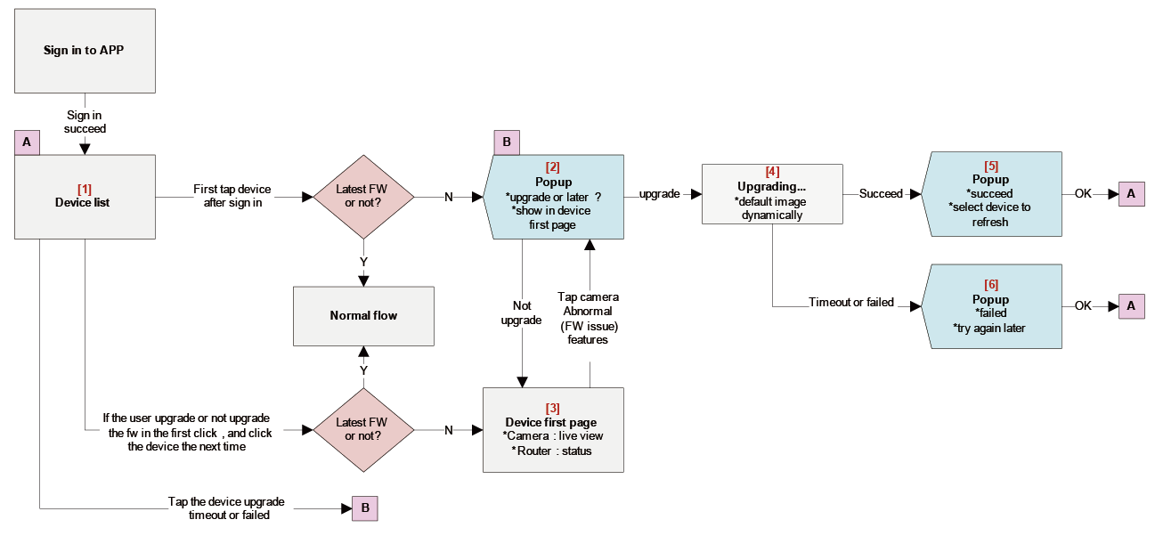
1.2.2 Firmware
1.2.2 [1]
1.2.2 [2]
1.2.2 [4]
1.2.2 [5]
[2]
[4]
[5]
[1]
[6]
[3]
1.2.2 [3]
1.2.2 [6]
Wireframe please refers to next 6 pages
After sign in, if not latest Firmware, show upgrade popup only once after user tap device.
If user upgrade failed(timeout or failed), allow show popup again after user tap device.

Slide 17
1.2.2 Firmware: [1] Device List

Slide 18
1.2.2 Firmware: [2] Pop up: Upgrade or later?
[Content from PP]
[Title 1] : New firmware available
[Text 1] : A new firmware is available for your device. Please upgrade your firmware and ensure you have access to the latest features.
[button] : Upgrade/Not upgrade

Slide 19
1.2.2 Firmware: [3] Device First Page
1. Show abnormal icon if old FW can not support.

Slide 20
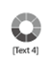
1.2.2 Firmware: [4] Upgrading…
[Content from PP]
[Text 4] : Upgrading…

Slide 21
1.2.2 Firmware: [5] Pop-up: Succeed
[Content from PP]
[Title 2] : Upgrade firmware successfully
[Text 2] : Your firmware has been upgraded to the latest version. Please go back to device list and select the device again to refresh the device features

Slide 22
1.2.2 Firmware: [6] Pop-up: Failed
[Content from PP]
[Title 3] :Failed to upgrade firmware
[Text 3] : firmware upgrade failed due to connection time out. Please try again later.

Slide 23
1.3.1 Menu
1.3.1a
1.3.1b1
1.3.1c1
1.3.1d
Freeze the original page in the right place of menu list.
Remove the “Settings” item originally and add a “Sign Out” in the end of Menu list.

Slide 24
1.3.1a Menu: Apps
Hiding this Apps item if there is no apps inside.
There should be three kinds of icon types for Apps: Existing App, Not Installed, Coming Soon.
[Text2]: Show the App Name in “Existing App” and “Not Installed”; show the Coming Soon in the “Coming Soon”
Wireframe and flow of Apps: see 2.1 to 2.4
Max number of apps in the list is 4, and apps are Align Center. The apps in the order after the first list are putted from left to right.
Content from PP
[Text]: Followings are apps you can use to empower your mydlink products:

Slide 25
1.3.1b1 Menu: News
1.3.1b2
This page is a web content.
The display length of news title in list could not be longer than one line, would be trimmed with “…”
Content: Defined by PP.

Slide 26
1.3.1b2 Menu: News: content
1.3.1b1
This page is a web content.
Content: Defined by PP.

Slide 27
1.3.1c1 Menu: Help
1.3.1c2
This page is a web content.
Show this page after loading finish.
Tap option will show the information from server.
The display length of news title in list could not be longer than two lines, would be trimmed with “…”
Content: Defined by PP.

Slide 28
1.3.1c2 Menu: Help: content
1.3.1c1
This page is a web content.
Content: Defined by PP.

Slide 29
1.3.1d Menu: About
mydlink logo
This page is a web content.
[Content]: Defined by PP.

Slide 30
1.4 New Features
From>> Sign in Success
“Done”: Skip Introduction and go to Device List, and these introduce pages will remove Done button and save to Help automatically.
The right page button is disabled in the Fist page, and the left page button is disabled in the Last page.
When new version have new feature, show introduce page between sign in page and my devices page.
One feature use one page to introduce, if content is too long, user can scroll up and down to read.
If new feature over two items, show next and previous icon on the bottom of pages(fixed), user can click to go to next page.
First item remove previous icon, last page remove next icon.

Slide 31
2. Unsupported Device

Slide 32
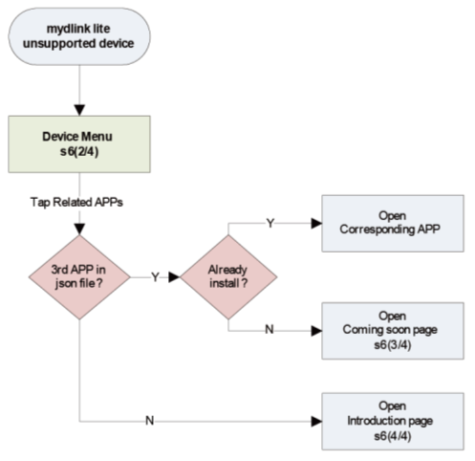
2.1 Unsupported Device Flow
Un-exist
2.3
Uninstall
2.4
If user tap device that unsupported in lite, that means this app should work with independent app.
Tap unsupported device to go to 2.2

Slide 33
2.2 Unsupported Device Flow: Related Apps in Device
Related
Apps
Show Related APPs in device menu page.
Each Apps has three scenario: Already install / uninstall / coming soon.
Tap related APPs will confirm 3rd party app in Jason file?
if Un-exist: go to 2.3
if existed: confirm this app already download?
(a) Already install: open app and log in account automatically.
(b) Uninstall: go to 2.4

Slide 34
2.3 Unsupported Device Flow: Related Apps in Device: Coming Soon
2.2
Content from PP
[Content]: This device model is not in the support list of mydlink mobile apps so far. Please stay tuned to the mydlink website News.

Slide 35
2.4 Unsupported Apps
2.2
App picture
App Store picture
[App’s Name] and [Content] are defined by PP.

Slide 36
A. Camera

Slide 37
A1. Cloud NVR

Slide 38
A2. Live View

Slide 39
A2.1 Live View
Live View
Multiple view
Full Screen
Question Mark
Changing the toolbar page by swiping left and right.
Changing to full screen view by button or double tapping the screen view.
The order and numbers of features see A2.1a
Auto fade out the screen view after 7 seconds on showing.
[text]: “Timeout 60 sec”, only appears when relay countdown less than 60 seconds. When relay count down to 0, show popup to remind user, user can choose back to previous page or resume.
PT controller: (1) Showing or Hiding the PT controller by single tapping the screen view. (2) appears and fade out after 5 seconds on entering live view. (3) show when entering pt supported live view. (4) hide after 7 seconds no tapping in camera view area. (5) hide when tapping any place else inside camera view area. (6) show from hidden when tapping any place inside camera view area
Tap the question icon to show the illustration about relay connection.

Slide 40
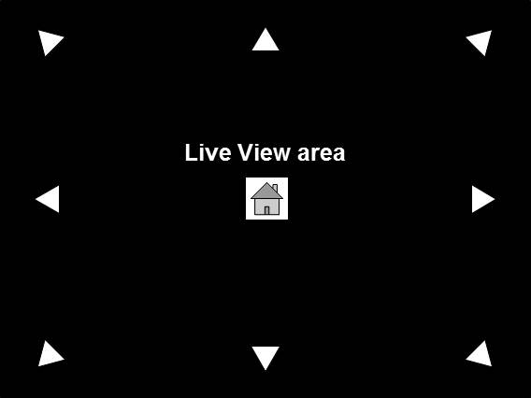
A2.1a Live View
Camera supported feature list with function button :
This feature list just for your reference and will be changed from PP.
Feature | Icon | Supported camera | Note
Info button |  | All camera currently. | Necessary
Mute button |  | All camera currently. | Necessary
Camera button (snapshot) |  | All camera currently. | Necessary
Fisheye button |  | DCS-6010L | Necessary
HD button (240p/480p) |  | DCS-942L/2132L/7010L/6010L/2310L/5222L/2332L | Necessary
Speaker button (two-way audio) |  | DCS-2132L/7010L/6010L/2310L/5222L/2332L | Necessary
Night view button |  | DCS-932L/942L/2132L/7010L/6010L/2310L/5222L (only DCS-930L don’t supported) | Necessary
PT controller |  | DCS-5222L | Necessary
Pan speed button |  | DCS-5222L (Follow PT controller ) | In the Future
Auto-pan button |  | DCS-5222L (Follow PT controller ) | In the Future
Brightness |  | DCS-932L/942L/2132L/7010L/6010L/2310L/5222L (only DCS-930L don’t supported) | In the Future
i
HD
HD
HD
HD
HD
HD

Slide 41
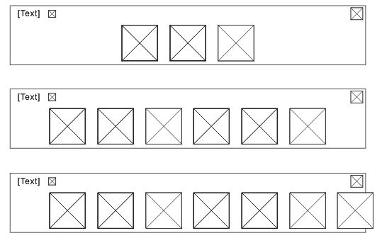
A2.1b Live View
The case in three features
.
.
.
.
The case in six features
.
.
.
.
The case in seven or more features.
The order of features(left to right): Mute, Snapshot, 2 way audio, Night View, Quality(HD), Fisheye, Turn angle, Quick Scan, Brighter, Information.
If camera don’t supported some feature or will implement in the future, the next feature will forward to fill the place automatically. The number of features are decided by the supporting of each. device.
Taking a camera shot: white solid and fade out in 1 second.
PT controller control the pan and tile of camera, only appears when camera support.
Drag the zoom slider to zoom in/out live view.
Tap the mute icon button to turn sound from camera on/off.
Tap the info icon button to show/hide live view info.
Tap camera icon button to take a snapshot of live view and save to camera roll.
In fisheye supported cameras, adding a “View mode” switch button which shows current view mode.
In 240p/480p supported cameras, adding a “HD” switch button witch triggers 240p/480p.
Function buttons show initially, and fade out automatically after 5 seconds of no action.
Tap live view area to show/hide function buttons.

Slide 42
A2.1c Live View: First time
Related
Apps
Live View
A2.1
This page is shown when user first time visits.
The order of features please follow A1.1a: Feature List: Cloud NVR → Live View→ Playback → Related Apps → Settings
Content from PP
[Title]: Related Apps
[Text]: Now, You can use Related Apps to launch your favorite apps to empower your camera, network storage, and more!

Slide 43
A2.2 Live View: Information
Live View
Information button: Pop-up a fly-out for showing the information. ( defined by RD/ system )

Slide 44
A2.3 Live View: Quality
Live View
Quality button: Pop-up a fly-out for quality tapping.
In supported cameras, adding a “HD ” switch button which shows current mode.
Show 240p as default, tap to slide options down or close options up.
Show options 240/480/HD, if device unsupported any option, remove the option and confirm all options should be place evenly distributed.
In mode of opening HD selection area, tap any place else on tool panel or live view area would close View mode selection area first.

Slide 45
A2.4a Live View: 2 way audio
If camera supported this feature, add a this button on camera’s Live view page, user can long press to talk.
Tap button then release, just show “Long press to talk” in wording area, and remove wording after 5 sec.
Long press to show “Long press to talk” in wording area, and remove after 5 secs. Change button status to highlight, user can speak directly.
If Someone is speaking, show popup “Someone is speaking, please try again later. ”and OK button, tap ok to close popup.
Release button to stop talking.

Slide 46
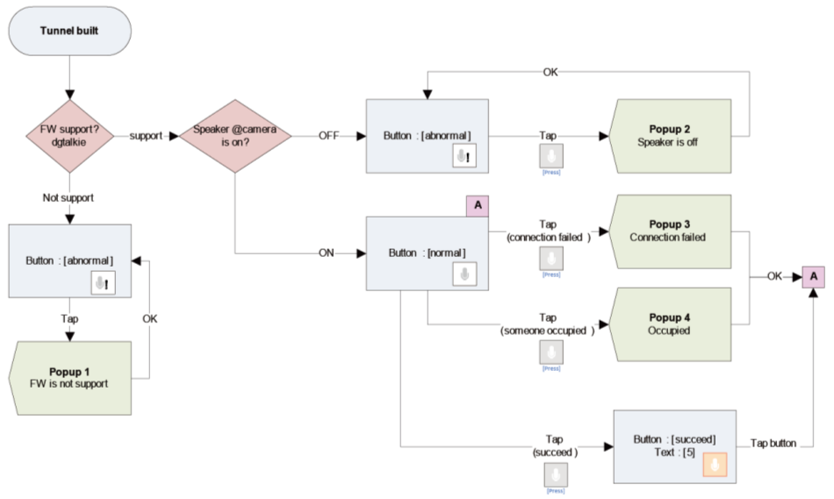
A2.4b Live View: 2 way audio
If camera supported this feature, add a this button on camera’s Live view page, user can click button to talk.
Button status and word description please refers to next page.

Slide 47
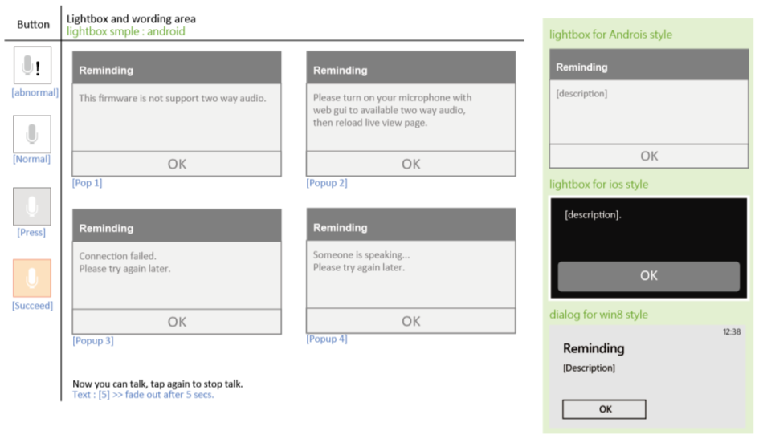
A2.4c Live View: 2 way audio

Slide 48
A2.5a Live View: Night View(1/2)
Live View
Night View button: Pop-up a fly-out for Night Mode tapping.
In night view supported cameras, adding a “night view mode” switch button which shows current view mode.
Tap night view button to switch mode.
Here are three mode : on/off/auto.
Be selected mode should be highlight.
Tap any option to select mode and close options.
In mode of opening View mode selection area, tap any place else on tool panel or liv view area would close View mode selection area first.

Slide 49
A2.5a Live View: Night View(2/2.continue)
Live View
night view feature in 931L/932L/932LB1/933L
Please create 3 mode : (Auto/On/Off)
Auto is default
On is equal to Always Night Mode
Off is equal to Always Day Mode
night view feature in 942L/5211L/5222L/2132L/2310L/7010L/6010L
Please create 2 mode : (On/Off)
Off is default, equal to Always Day Mode
On is equal to Always Night Mode
Off is Please remove auto mode and show On and Off mode in the middle of control box.

Slide 50
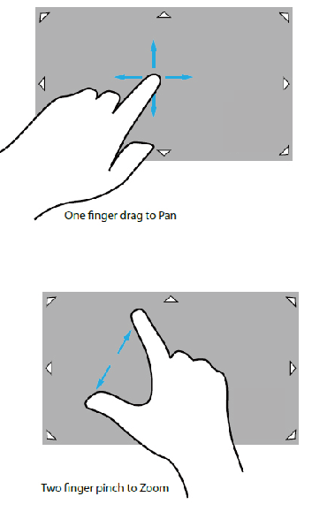
A2.6 Live View: ePTZ Activated
ePTZ feature in live view page :
One finger drag to pan.
Two finger pinch or double tap to zoom, behavior will be followed to difference phone.

Slide 51
A2.7 Live View: Multiple View
Mute
Normal
Live view
information
Features according to different Camera supported.
Tap “Mute” Button to close/open the audio to all the views.
Tap “Information” Button to close/ open the information to all the views.
The default of information is close.
The original view before Multi-view is set in the top-and-most left location.
Countdown 60secs is only for original view. Show the words ‘Please tap this view if you want to resume’ in the center of original view. User could resume the original view by tapping the view.
If any camera’s view connection failed, show the [text] in the center of view. user could tap the view again to reconnect it.
Content from PP
[Text]: Connect failed, please tag view again to reconnect it

Slide 52
A2.8 Live View: Switch View Mode
Tap view mode button to open a popover for user to switch view mode which depends on mount type; [ item] s are listed as follow and defined by device.
Ceiling - 1O - 1R - 2P - 1O3R - 4R
In fisheye supported cameras, adding a “View mode” switch button which shows current view mode.
In mode of opening View mode selection area, tap any place else on tool panel or liv view area would close View mode selection area first.
The figures of item are designed by VD.
Wall - 1O - 1R - 1P2R - 1O3R - 4R
Desktop - 1O - 1R - 2P - 1O3R - 4R

Slide 53
A2.9a Live View: Single camera live view
Normal
Live view
If device just have info/mute/snapshot three features, just show these features in this area.
If device supported fisheye or HD or two way audio features, add dots in this area below, user can slide gesture on this area to see fisheye /HD/two way audio features, refer to next page.
The dot will be highlight when user go to corresponding page.
Double tap the live view area or tap normal screen to switch to Camera live view.
Fade out the status and title bar after 5 seconds of no tapping automatically.
In fisheye supported cameras, adding a “View mode” switch button which shows current view mode
In 240p/480p supported cameras, adding a “HD” switch button witch triggers 240p/480p
Double tap the live view area to switch to Camera live view.
Fade in the status and title bar after any tap

Slide 54
A2.9b Live View: Single camera live view: two way audio
Normal
Live view
If camera supported this feature, add a this button on camera’s Live view page, user can long press to talk.
Tap button then release, just show “Long press to talk” in wording area, and remove wording after 5 sec.
Long press to show “Long press to talk” in wording area, and remove after 5 secs. Change button status to highlight, user can speak directly.
If Someone is speaking, show popup “Someone is speaking, please try again later. ”and OK button, tap ok to close popup.
Release button to stop talking.
Single camera live view: see A2.9c

Slide 55
A2.9b Live View: Single camera live view: two way audio
Normal
Live view

Slide 56
A3. Playback

Slide 57
A3.0 Playback: Entrance
A3.1a /
A3.1b /
A3.1c /
A3.2.1a/
A3.2.1b
Playback
Modify device page’s style.
Add playback option if camera supported SD card.
There are four situations after tap Playback: (1) A3.1a Scenario 1: Unable to access our SD card (2) A3.1b Scenario 2: Need to format SD card first (3) A3.1c Scenario 3: When there is no clip in Playback (4) A3.2.1a / A3.2.1b Scenario 4: Playback: Date.

Slide 58
A3.1a Playback: Scenario 1: Unable to access our SD card
Playback
“Refresh”: re-access SD card.
Content from PP
[Title]: Unable to access your micro SD card.
[Text]: Please make sure that the microSD card is properly inserted into the Cloud Camera. Then click Refresh to try again.

Slide 59
A3.1b Playback: Scenario 2: Need to format SD card first
Playback
“Format”: format SD card, succeed will go to A3.1c
Content from PP
[Title]: This micro SD card is not format yet.
[Text]: Please format micro SD card first.

Slide 60
A3.1c Playback: Scenario 3: When there is no clip in Playback
Playback
A3.2.2
A3.3.1
”Refresh”: Reload playback.
Content from PP
[Title]: No Video Clip
[Text]: Please tap Refresh to reload it.

Slide 61
A3.2.1a Playback: Scenario 4a: Playback: Date: for APPRO
Playback
A3.2.2
A3.3.1
Tap ”Refresh” Button: Reload playback.
Content from PP
[Title]: Looking for video clip
[Text]: Please tap Quick Find

Slide 62
A3.2.1b Playback: Scenario 4b: Playback: Date: for NIPICA
Playback
A3.2.2
A3.3.1
A3.2.3
Tap ”Refresh” Button: Reload playback.
The Date items are presented from new to old.
[Date]: the style is defined by system.(Ask RD Provide )

Slide 63
A3.2.2 Playback: Quick Find
Playback
A3.1c/
A3.2.2a/
A3.2.2b
A3.2.3/
A3.2.2a
“Done” : (1) If have playback in the date, go to A3.2.3.
(2) If not, no playback interval in A3.2.2a.

Slide 64
A3.2.2a Playback: Quick Find: warning
Playback
A3.2.1a/
A3.2.1b
.
Content from PP
[Text]: There is no clip inside.

Slide 65
A3.2.3 Playback: Time zone
A3.2.1
Playback figure
A3.3.1
A3.2.4
Playback is a sign which can not be tap.
Tap ”Refresh” Button: Reload playback.
The Timezone items are presented from new to old.
[Timezone]: the style is defined by system ( with distance: one hour ) .(Ask RD Provide )

Slide 66
A3.2.4 Playback: Clip
A3.2.3
Playback figure
A3.4.1
A3.3.1
Clip’s snapshot
A3.2.5
Playback is a sign which can not be tap.
Clip Name is defined by RD.
The clips are presented from new to old.

Slide 67
A3.2.5 Playback: Player
A3.2.4
Playback figure
Playback is a sign which can not be tap.
If recording type unsupported toolbar, please skip the description about tool bar.
The tool bar is set up under the video view independently ( by RD Eric )
The tool bar and the function of full screen are defined by iOS. ( by RD Eric )

Slide 68
A3.2.6 Playback: Data number definition
Playback
[Date]
The 100 th Date
If the number of data in A3.2 is more than 100 (not included), show the 101st item under the 100th item of data automatically.
The Date items are presented from new to old.

Slide 69
A3.2.7 Playback: Data number definition
Playback
The 101 st Date
The 101 st item is presented in the top of list .
The 101 st item is still under the 100 th item.
User could slide up to view the item before 101 st .
The Date items are presented from new to old.

Slide 70
A3.3.1 Playback: Settings
This is an example from A3.2.1
Playback
Settings Area is
Expanded
& Collapsed
A3.3.2
A3.3.3
Original
Area is
Pushed
down
Text content default: hide.
Some device cannot format SD card when recording is enable, if the case happen, disable SD card format button and show the [Text].
After tapping “settings” button in the last page, the settings area is expanded and original area is pushed down.
Tap “settings” button again in this page, the settings area is shortened and closed and original area is collapsed.
The Date items are presented from new to old.
[Date]: the style is defined by system. (Ask RD Provide )
Content from PP
[Text]: The SD card can not be formatted when recording is enable, please stop recording with computer or tablet first.

Slide 71
A3.3.2 Playback: Settings: State
Playback
A3.3.1
“Continue…” or “Stop…” are mutually exclusive.
Text: Default is hide.
Tick continue and overwrite, show [text 1].
Tick stop recording, show [text 2].
Content from PP
[text 1]: Continue recording and overwrite the oldest video.
[text 2]: Stop recording and notify me if I enabled E-mail notifications with PC or tablet.

Slide 72
A3.3.3 Playback: Settings: Format
Playback
Format
success
A3.3.1
A3.3.1
A3.3.4
Format
Un-success
.
Content from PP
[Text]: All your data will be deleted. Do you really want to format your micro SD card?

Slide 73
A3.3.4 Playback: Settings: Recording on
Playback
A3.3.1
this Scenario is happened as recording on, ask user to go to settings to stop recording first.
Content from PP
[Text]: Please go to settings to stop recordings first.

Slide 74
A3.4.1 Playback: Remove page ( only in the clip page )
A3.2.4
A3.2.4
Without changed
Clip’s snapshot
A3.4.3
With changed
Tick checkbox to choose data in the list.
Tick the item all, will tick all checkbox automatically.
If user tick the item all, then un-tick any date in the list, will un-tick the item all atomically.
Clip Name is defined by RD.
The clips are presented from new to old.

Slide 75
A3.4.2 Playback: Remove: Confirm Page
Success
A3.4.1
A3.2.4
Fail
A3.4.3
Content from PP
[Text]: Do you really want to remove clips you select?

Slide 76
A3.4.3 Playback: Remove: Remove fail
A3.2.4
Content from PP
[Text] One or more clips cannot be remove, it might be the file is recording.

Slide 77
A4. Related Apps

Slide 78
A4.1 Related Apps: Entrance
Related
Apps
There should be two kinds of icon types for Apps: Existing App, Not Installed.
[Text2]: Show the App Name in “Existing App” and “Not Installed”.
The max number of apps in the list is 4, and apps are Align Center. The apps in the order after the first list are putted from left to right.
Tap app will confirm this app has already been downloaded or not.
If Already download: : open app and log in mydlink account automatically.
If Un-download: go to 2.4
.
Content from PP
[Text]: Following s are apps you can use to empower your mydlink products:

Slide 79
A5. Camera Settings

Slide 80
A5.0a Camera Settings: Entrance
Settings
A5.4.1
A5.1.1
A5.2.1
A5.3.1
A5.5.1
With SD card, show the scheduled recording.
Disable the scheduled recording, if the schedule is set up in Motion Detection or Sound Detection.
Disable the Motion Detection and Sound Detection, if the schedule is set up in scheduled recording.
Tap device name to rename with popup style.
If user tap the other place outside the view without apply or cancel, please show a popup with [Text*] and OK button.
If the device support PIR, and the user turn on the Motion Detection on portal, it will show "Motion Detection with PIR.“
If any edit, show Apply/Reset on the bottom of this page.
Settings items are showed or no-showed following device.(defined by RD)
.
[Text*] “Please apply or cancel your settings before you leave this page.” ( Ask PP Provide )

Slide 81
A5.0b Camera Settings: Entrance (continue)
Settings
If camera support extender mode but wireless is not opened , show more settings title and extender mode option, disable switch button, and show wording [text3].
Event Trigger Settings : [text 1] default : show; [text2] default : hide
Some device support event trigger only when E-mail notification enabled:
If e-mail notification is turned on: Enable sound/motion detection switch button. Show [text1] and hide [text2].
If e-mail notification is turned off: Disable sound/motion detection switch button. Hide [text1] and show [text2].
.
[Text1] “If you want to do more event trigger settings, please setting with computer or tablet.” ( Ask PP Provide )
[Text2] “Before setting event trigger settings, please enable e-mail notification with computer or tablet first.” ( Ask PP Provide )
[Text3] “You cannot enable extended mode because that wireless of this camera is disabled.” ( Ask PP Provide )

Slide 82
A5.0c Camera Settings: Entrance (continue)
Settings
Tap Cancel will show a popup to confirm with “Yes” button to close popup and back to original settings, “No” button to close popup, and [title1][content 1].
Tap Apply:
If the settings user edit should be reload, will show a popup with “Yes” button to reload, “No” button to close popup, [title 2][content 2].
If the settings user edit should not be reload, skip the popup.
.
[Title1] “Reminding” ( Ask PP Provide )
[Content1] “Your setting changes have not applied yet and will be cleared. Do you want to continue?” ( Ask PP Provide )
[Title2] “Reminding” ( Ask PP Provide )
[Content2] “It will take [x] seconds to apply the settings. Do you want to continue?” ( Ask PP Provide )

Slide 83
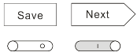
A5.1.1 Camera Settings: Motion Detection: Entrance
A5.0
A5.0
“Cancel”: go to A5.0 without change setting of Motion Detection.
If Motion Detection is closed, then show the Save button; if Motion Detection is opened, show the Next button.
A5.0
A5.1.2

Slide 84
A5.1.2 Camera Settings: Motion Detection: Active Area
A5.0
A5.1.3
“Cancel”: go to A5.0 without change setting of Motion Detection.
Push the ”Clear All” button, Clean all set-up in the Active Area.
Active Area: the matrix is defined by RD and PP.
Content from PP
[Text]: “Mark the areas you want to monitor for movement by pointing and lengthening.” descripting the method of using

Slide 85
A5.1.3 Camera Settings: Motion Detection: Schedule
A5.0
A5.1.4
A5.1.3a
“Cancel”: go to A5.0 without change setting of Motion Detection.
Always / Repeat are single choose.

Slide 86
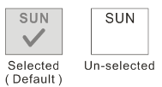
A5.1.3a Camera Settings: Motion Detection: Schedule: Repeat
A5.1.3
These items are multiple choose. And the default is “whole week”(always).
Time picker is defined by system (RD).

Slide 87
A5.1.4 Camera Settings: Motion Detection: Recording
A5.0
A5.0
“Cancel”: go to A5.0 without change setting of Motion Detection.
“Recording whenever… “ is single choose.

Slide 88
A5.2.1 Camera Settings: Sound Detection: Entrance
A5.0
“Cancel”: go to A5.0 without change setting of Sound Detection.
If Sound Detection is closed, then show the Save button; if Sound Detection is opened, show the Next button.
A5.0
A5.2.2

Slide 89
A5.2.2 Camera Settings: Sound Detection: Threshold
A5.0
A5.2.3
“Cancel”: go to A5.0 without change setting of Motion Detection.
Sound Threshold: the histogram is defined by RD and PP.
[dB]: show the present sound value.
Content from PP
[Text]: “Drag the blue button to select a volume level. Your camera will check for any sound that is louder than the volume level you set.” descripting the method of using

Slide 90
A5.2.3 Camera Settings: Sound Detection: Schedule
A5.0
A5.2.4
A5.2.3a
“Cancel”: go to A5.0 without change setting of Motion Detection.
Always / Repeat are single choose.

Slide 91
A5.2.3a Camera Settings: Sound Detection: Schedule: Repeat
A5.2.3
These items are multiple choose. And the default is “whole week”(always).
Time picker is defined by system (RD).

Slide 92
A5.2.4 Camera Settings: Sound Detection: Recording
A5.0
A5.0
“Cancel”: go to A5.0 without change setting of Sound Detection.
“Recording whenever… “ is single choose.

Slide 93
A5.3.1 Camera Settings: Cycle Recording: Entrance
A5.0
A5.0
“Cancel”: go to A5.0 without change setting of Cycle Recording.
If Cycle Recording is closed, then show the Save button; if Cycle Recording is opened, show the Next button.
A5.0
A5.3.2

Slide 94
A5.3.2 Camera Settings: Sound Detection: Schedule
A5.0
A5.0
A5.3.2a
“Cancel”: go to A5.0 without change setting of Motion Detection.
Always / Repeat are single choose.

Slide 95
A5.3.2a Camera Settings: Cycle Recording: Schedule: Repeat
A5.3.2
These items are multiple choose. And the default is “whole week”(always).
Time picker is defined by system (RD).

Slide 96
A5.4.1 Camera Settings: Notifications
A5.0
A5.0
“Cancel”: go to A5.0 without change setting of Notifications.
If Notifications is closed, then show the Save button; if Notifications is opened, show the Next button.
A5.0
A5.4.2
Content from PP
[Text]: “When enabled, notification will be sent to your mydlink registered e-mail address when specific events occur”

Slide 97
A5.4.2 Camera Settings: Notifications: Account: Scenario 1
A5.0
A5.0
A5.4.3
Show the @xxx.xxx (defined by user selecting) on the right side of “Account:” after user selecting
Content from PP
[Text1]: Warning message( defined by RD / system )
[text2]:”This information will be stored on your device only, and will only be used to send you event notification e-mails.”

Slide 98
A5.4.3 Camera Settings: Notifications: Account: Email
A5.4.2
The option is defined by PP/ RD.
If user choose option: mailServer then tap Back button, go to E4.4

Slide 99
A5.4.4 Camera Settings: Notifications: Scenario 2
A5.0
A5.0
A5.4.3
A5.4.5
Show the @xxx.xxx (defined by user selecting) on the right side of “Account:” after user selecting
Show the state words here
Content from PP
[Text1] & [Text2]: Warning message ( defined by RD / system )
[text3]:”This information will be stored on your device only, and will only be used to send you event notification e-mails.”

Slide 100
A5.4.5 Camera Settings: Notifications: Account: Email
A5.4.4
These option are defined by PP/ RD. This frame present the style only.

Slide 101
A5.5.1 Camera Settings: Extended Mode
A5.0
A5.0
“Cancel”: go to A5.0 without change setting of Notifications.
A5.0
A5.5.2

Slide 102
A5.5.2 Camera Settings: Extended Mode
A5.0
A5.0
Reset to Default: Overwrite settings with Router settings

Slide 103
B. Router

Slide 104
B1. Status

Slide 105
B1.1 Router: First time
Related
Apps
Status
B1.3.1
This page is shown when user first time visits.
The order of features please follow: Statue → Related Apps → Settings
[Router Status]: see B1.3.1
Content from PP
[Title]: Related Apps
[Text]: Now, You can use Related Apps to launch your favorite apps to empower your camera, network storage, and more!

Slide 106
B1.2 Router: Status: No Device
Status
show [text] if there is no device link to the router.
Content from PP
[Text]: No Device

Slide 107
B1.3.1 Router: status
Status
B1.3.2
Uploads Figure
Router’s Figure
Download’s Figure
refresh’s Figure
Device’s Figure
B1.3.5a
B1.3.5b
If device no wireless, just show router picture.
If device have wireless, and it’s turn off, show wireless turn off icon.
If device have wireless, and it’s turn on, show wireless turn on icon.
Tap the “upload and download section” to refresh.
If there is no device in the Connection List, show the [text1]; If there is no device in the Suspect List, show the [text2]
Content from PP
[Text1]: There is no device connect to your device.
[Text2]: There is no suspect device.

Slide 108
B1.3.3 Router: reset/apply
Status
B1.3.4d
If user revise some settings and tap the features outside the status, show the “Apply” and “Reset” button under the router status.
These two button is fixed on the bottom of the router status.

Slide 109
B1.3.4a Router: warning
Status
B1.3.1
B1.3.1
If “Tap Reboot with some settings changed”, shows [text] no.1
If “Tap Reboot with Connection List & Suspect list modified”, shows [text] no.2
Content from PP
[Text No.1] “Your setting changes have not applied yet and will be cleared. It will take 80 seconds to reboot the router. Do you want to continue?”.
[Text No.2] “ The suspect list will be cleared. It will take 80 seconds to reboot the router. Do you want to continue?”.

Slide 110
B1.3.4b Router: warning(continue)
Status
B1.3.1
B1.3.1
If “Tap Reboot with both settings and Connection List/Suspect List changed ”, shows [text] no.3
If “ Tap any device else on device list”, shows [text] no.4
Content from PP
[Text No.1] “ Your setting changes have not applied yet and will be cleared. The suspect list will be cleared. It will take 80 seconds to reboot the router. Do you want to continue?”.
[Text No.4] “Your setting changes have not applied yet and will be cleared. Please apply or reset it”.

Slide 111
B1.3.4c Router: warning(continue)
Status
Close the pop-up
Any thing changed first time, this dialog would popup to remind user.
Content from PP
[Text]: Your setting changes will take effect after clicking the “Apply” button on the main page of your [device name].

Slide 112
B1.3.4d Router: warning(continue)
Status
If “Tap Apply ” in B1.3.3, shows [text] no.4
If “Tap Reset ” in B1.3.3, shows [text] no.5
Content from PP
[Text No.4]: It will take 50 seconds to apply the settings. Do you want to continue?
[Text No.5]: Your setting changes have not applied yet and will be cleared. Do you want to continue?

Slide 113
B1.3.5a Router: connected device
B1.3.1
When tap to enter a connected device. Tap “Block this device” to block this device
When changing anything first time, a dialog would popup to warn user saving and reboot issue.
User can’t block the device they are using, if tap the device, remove block this device button.

Slide 114
B1.3.5b Router: connected device
B1.3.1
[ Action name ] = [ Block this device ]
When tap to enter a suspect device, tap “Block this device” to block this device
When changing anything first time, a dialog would popup to warn user saving and reboot issue.
[ Action name ] = [ Unblock this device ]
When tap to enter a blocked device, tap “Unblock this device” to unblock this device
When changing anything first time, a dialog would popup to warn user saving and reboot issue.

Slide 115
B2. Related Apps

Slide 116
B2.1 Router: Related Apps
Related
Apps
There should be three kinds of icon types for Apps: Existing App, Not Installed, Coming Soon.
[Text2]: Show the App Name in “Existing App” and “Not Installed”; show the Coming Soon in the “Coming Soon”
Tap app will confirm this app has already been downloaded or not.
If Already download: : open app and log in mydlink account automatically.
If Un-download: go to 2.4
The max number of apps in the list is 4, and apps are Align Center. The apps in the order after the first list are putted from left to right.
Content from PP
[Text]: Following s are apps you can use to empower your mydlink products:

Slide 117
B3. Router Settings

Slide 118
B3.1.1 Router: Settings without dual-band
Settings
B3.2.1
B3.3.1
B3.4.1
Appear only when Wireless enable and no dual-band router.
When remote connection mode, all these settings would be disable.
Tap to edit enable/disable Wireless, edit network name(SSID), set Security Mode.
Wireless Network can not input Chinese.

Slide 119
B3.1.2 Router: Settings with dual-band
Settings
B3.2.1
B3.2.1
B3.3.1
B3.4.1
Appear only when Wireless enable and for dual-band router.
When remote connection mode, all these settings would be disable.
Tap to edit enable/disable Wireless, edit network name(SSID), set Security Mode.
Wireless Network can not input Chinese.

Slide 120
B3.2.1 Router: Settings: Security Mode
B3.1.2
B3.2.2
“Disable”, “WEP”, “WPA/WPA2”: single choose, When check mode that needs to set Key, slide to “Network Key” view automatically.
“Wireless Password” is disappear when Security Mode is Disable.

Slide 121
B3.2.2 Router: Settings: Security Mode: Network Key
B3.2.1
B3.2.1
Wireless password wording: For WEP -> 5 or 13 characters; For WPA/WPA2 -> 8~63 characters
Without preset password value [Done] would be disable until password value is acceptable, Enable only when format of Port input is acceptable [Cancel] would also reset Security Mode to Disable value and slide to Security Mode view
With preset password value [Done] would only be enable when password value change and acceptable, Enable only when format of Port input is acceptable [Cancel] would also reset Security Mode to previous value and slide to Security Mode view

Slide 122
B3.3.1 Router: Settings: Event Notification
B3.1.2
B3.3.2
Tap to check on/off event types for E-mail Notification.
When checking on without E-mail set before, slide to E-mail setting immediately.
When changing anything first time, a dialog would popup to warn user saving and reboot issue.
Content from PP
[Text]: Set up an e-mail to send notification:

Slide 123
B3.3.2 Router: Settings: Event Notification: Email warning
B3.3.1
B3.3.2
The popup fade out after 3 seconds or any tap automatically, then go to B3.3.3
Content from PP
[Text]: Please fulfill the e-mail setting for sending notification.

Slide 124
B3.3.3 Router: Settings: Event Notification: Email: case1
B3.3.1
B3.3.2
B3.3.4
B3.3.6b
“Done”: Enable only when format of E-mail input is acceptable and necessary forms are all filled.
“Cancel”: Back to Notification Settings and also cancel the E-mail Types if no e-mail set before
When changing anything first time, a dialog would popup to warn user saving and reboot issue
Test button should be enable only when necessary forms are all filled.
Content from PP
[Text]: The notification will be sent to your mydlink registered e-mail address.

Slide 125
B3.3.4 Router: Settings: Event Notification: Email: Email service
B3.3.3
The items in the email service is single selection.
The items are: Gmail, Hotmail, 126, 139, 163, QQ, Sina, Sohu, Sogou, Other

Slide 126
B3.3.5 Router: Settings: Event Notification: Email
B3.3.1
B3.3.2
B3.3.4
B3.3.6b
B3.3.6a
“Cancel” button would reset this E-mail notification type into previous value and slide to Event Notification Settings view.
When user tap to E-mail which had set before, it would slide to the setting view with value.
“Done” button would only enable when necessary forms are changed without empty.
Tap “Address” to edit address.
Tap “Password “to edit password.
Content from PP
[Text]: The notification will be sent to your mydlink registered e-mail address.

Slide 127
B3.3.6a Router: Settings: Event Notification: Email: warning 1
Clear & go to B3.3.5
B3.3.5
When tap remove in dialog, it slide to Event Notification Settings view and clear all checks of event notifications.
Content from PP
[Text]: Do you really want to remove this notification method? Remove it will also un-check all event types

Slide 128
B3.3.6b Router: Settings: Event Notification: Email: warning 2
B3.3.5
When tapping “Test” button, it would try to access and send an test e-mail from the input data.
If successful, it popup successful dialog. If failed popup a failed dialog to ask user confirm e-mail data.
Test Successfully
[Title] “E-mail Test”.
[Text] “Test OK.”.
Test Failed
[Title] “Could not send test e-mail”
[Text] “Please check your e-mail account settings and try again. (Error 407)”

Slide 129
B3.3.7a Router: Settings: Event Notification: Email: case2
B3.3.1
B3.3.2
B3.3.4
B3.3.7b
“Done” button would only enable when necessary forms are all filled and acceptable.
Content from PP
[Text]: The notification will be sent to your mydlink registered e-mail address.

Slide 130
B3.3.7b Router: Settings: Event Notification: Email: case2 warning
B3.3.7a
Content from PP
[Text]: Your setting changes will take effect after clicking the "Apply" button on the main page of your [device name].

Slide 131
B3.4.1 Router: Settings: Remote Web Access
B3.1.2
B3.4.2
“Remote web access” : When enable, slide to Port view for setting Port
“Port”: Appear only when Remote management enable and popup dialog immediately when enable
Content from PP
[Text]: Sync with port value

Slide 132
B3.4.2 Router: Settings: Remote Web Access: Port
B3.4.1
B3.4.1
[Port items]: 80, 88, 1080, 8080; Tap to choose port.

Slide 133
C. NVR
(DNR-322L)

Slide 134
C1. DNR-322L

Slide 135
C1.1a DNR-322L: First time
Camera
Related
Apps
C1.1b
This page is shown when user first time visits.
The order of features please follow: Camera→ Related Apps
Content from PP
[Title]: Related Apps
[Text]: Now, You can use Related Apps to launch your favorite apps to empower your camera, network storage, and more!

Slide 136
C1.1b DNR-322L: Never signed in successfully
Camera
This page is shown when user never signed in successfully.
“Username” is preset and unchangeable
If user input correct password before, pass this view and slide to Connected cameras view C1.1c directly.
Content from PP
[Text]: Please enter the admin password to access:

Slide 137
C1.1c DNR-322L: Ever signed in successfully
Camera
C2.1
This page is shown when user ever signed in successfully.
List all the camera list sent from NVR(including offline camera)

Slide 138
C1.2.1 DNR-322L: Cameras
Camera
All behavior in normal screen or full screen are the same with camera’s live view.

Slide 139
C1.3 DNR-322L: Related Apps
Related
Apps
There should be three kinds of icon types for Apps: Existing App, Not Installed, Coming Soon.
[Text2]: Show the App Name in “Existing App” and “Not Installed”; show the Coming Soon in the “Coming Soon”
Tap app will confirm this app has already been downloaded or not.
If Already download: : open app and log in mydlink account automatically.
If Un-download: go to 2.4
The max number of apps in the list is 4, and apps are Align Center. The apps in the order after the first list are putted from left to right.
Content from PP
[Text]: Following s are apps you can use to empower your mydlink products:

Slide 140
D. DIR-508 + DCS-300

Slide 141
D. DIR-508 + DCS-300 ( iOS only )
DIR-508 + DCS-300
Tap: Live View, Playback, Related Apps, Settings
Tap
DIR-508
Have 300 cam or not
Device List
Tap: Related Apps
DIR-508 only

